Slide 1
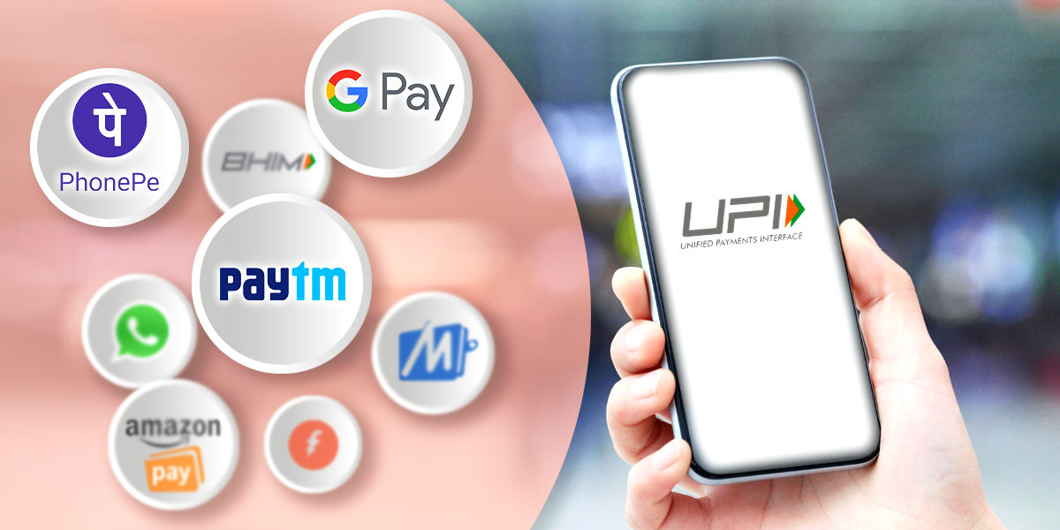
Unveiling UPI App Dynamics: Market Analysis in India
Chavi
M.Sc. Statistics

Slide 2
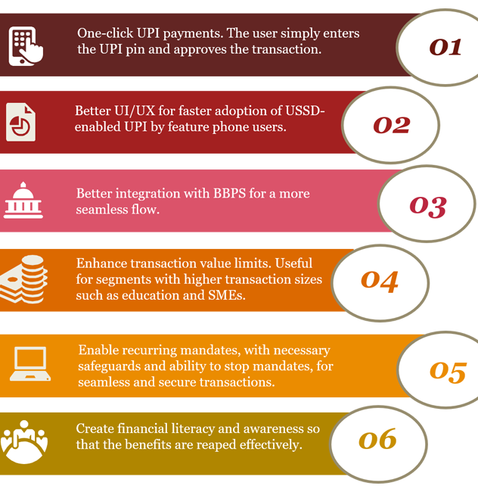
Unified Payments Interface (UPI)
Unified Payments Interface (UPI) is a system that powers multiple bank accounts into a single mobile application (of any participating bank), merging several banking features, seamless fund routing & merchant payments into one hood. It also caters to the “Peer to Peer” collect request which can be scheduled and paid as per requirement and convenience.
With the above context in mind, NPCI conducted a pilot launch with 21 member banks. The pilot launch was on 11th April 2016 by Dr. Raghuram G Rajan, Governor, RBI at Mumbai. Banks have started to upload their UPI enabled Apps on Google Play store from 25th August, 2016 onwards.

Slide 3
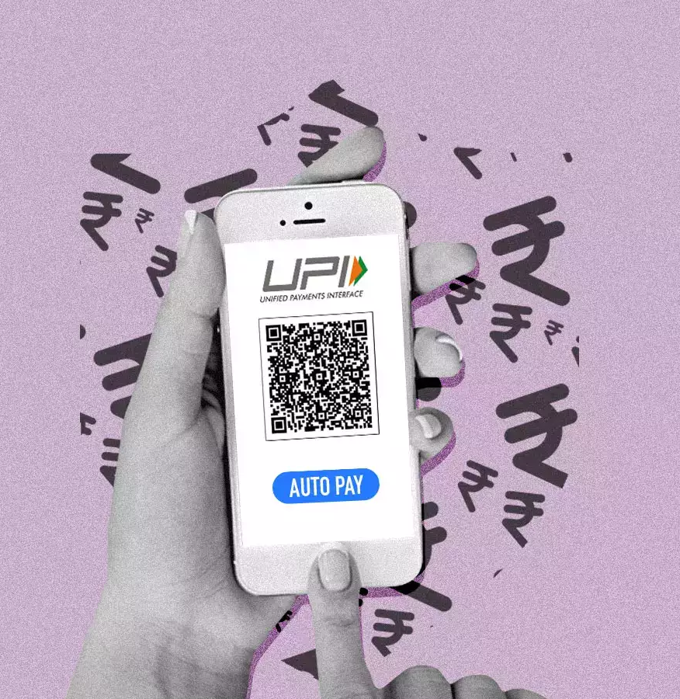
ABSTRACT
This project provides a thorough market analysis of Unified Payments Interface (UPI) apps in India, focusing on their evolution, impact, and pivotal role in the nation's digital financial landscape. The study investigates the historical development of UPI, analyzes prominent UPI apps, examines regulatory frameworks, and explores collaborative efforts shaping the ecosystem.

Slide 4
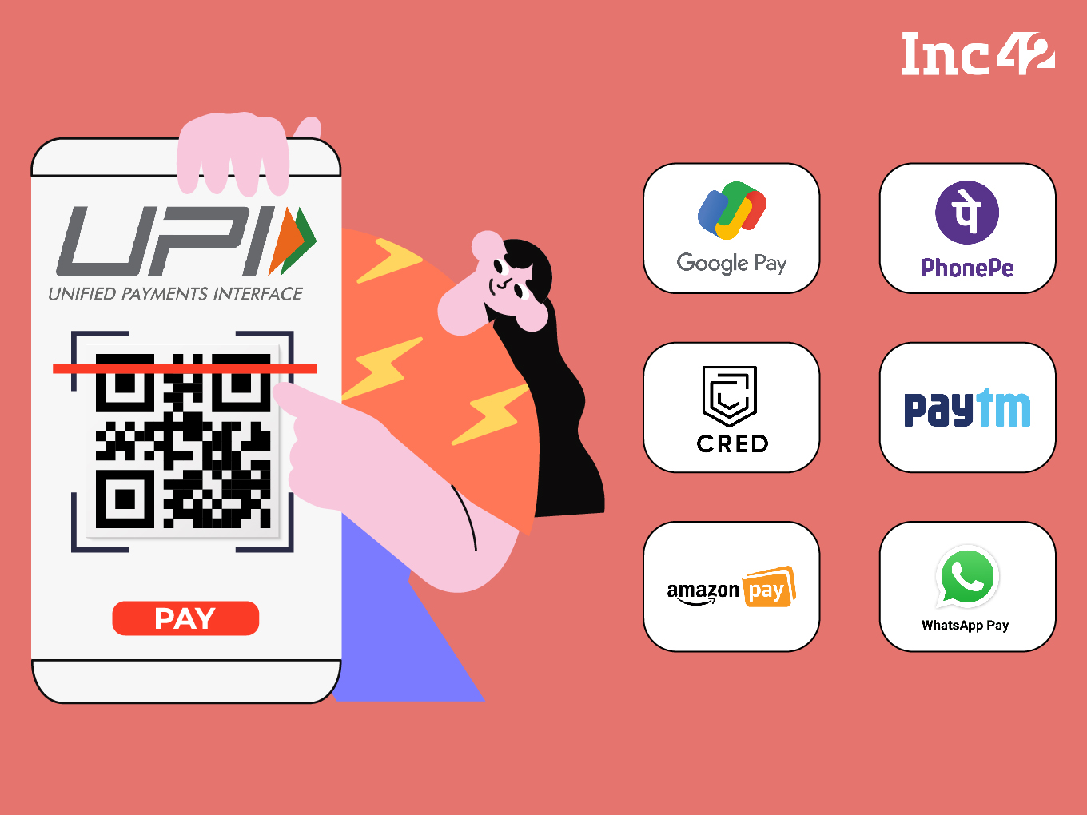
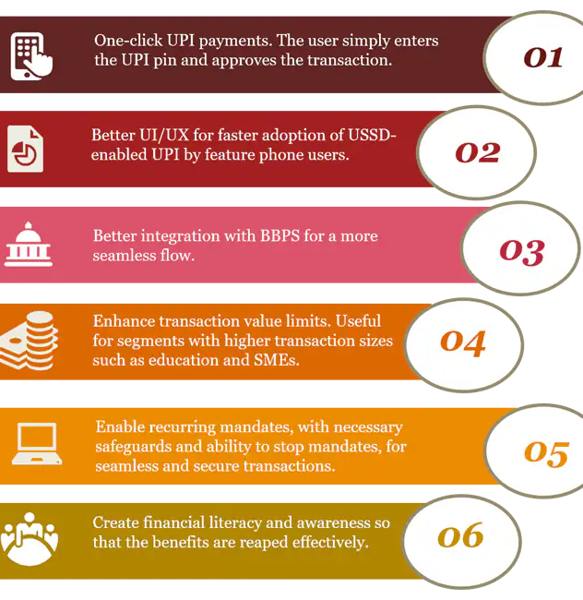
OBJECTIVE OF THE STUDY:
The main objective of the study is to analyze the Indian market of Unified Payments Interface (UPI) Apps.

Slide 5
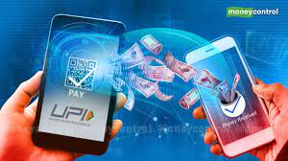
Guide:
About Data
Source of data, Sample Data, Data description.
Literature
Literature related to UPI and other project reviews
Analysis
Methodology, statistical techniques
Summary

Slide 6
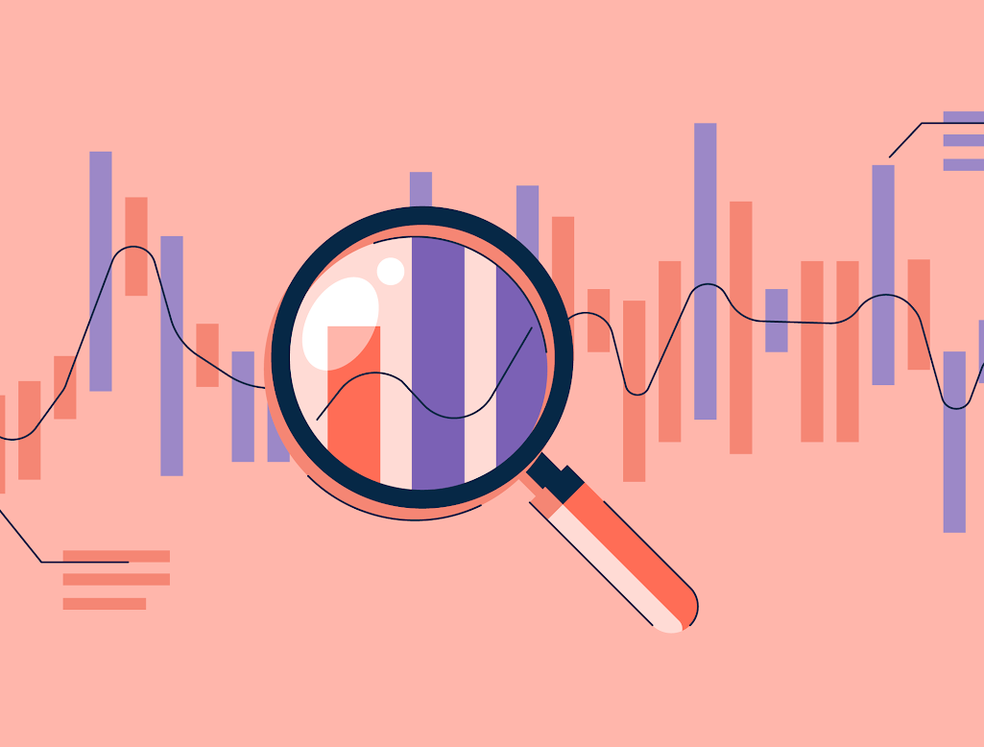
ABOUT DATA
data, data, data, data, data, data, data, data, data . data. Data .
Source of data, Sample Data, Data description.

Slide 7
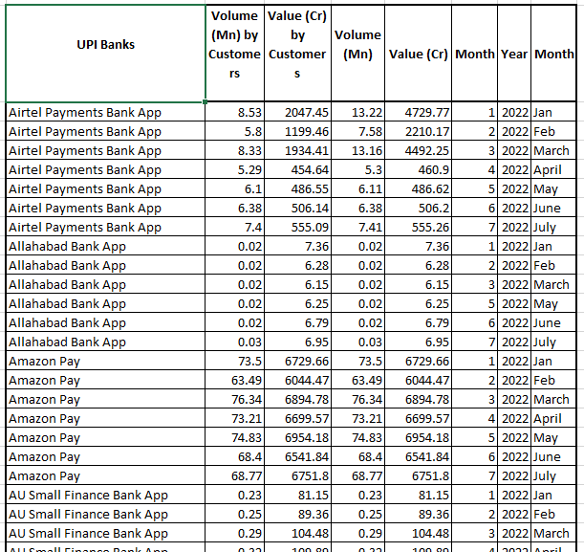
Sample Dataset, Source and Description:
The dataset was downloaded from Kaggle after confirming that the dataset was previously scrapped from the official site of NPCI (National Payments Corporation of India )
The dataset has 8 variables namely –UPI Banks/Apps, Volume of transaction by Customers in Millions, Value of transactions by Customers in Crores, Total Volume of transactions in Millions, Total Values of transactions in Crores , Months (in Numbers), Year and Months (in Words).
Here we have data of quantity and amount of UPI transactions of 75 banks and apps in the months of January to July for the year 2022.

Slide 8

Literature
data, data, data, data, data, data, data, data, data. data. Data .
Literature related to UPI and other project reviews

Slide 9
Introduction and Background: UPI was introduced by the National Payments Corporation of India (NPCI) in 2016 to facilitate instant money transfers between bank accounts through mobile devices. It operates on a real-time basis and has gained widespread popularity for its simplicity and convenience.
About Unified Payments Interface (UPI)
Growth and Adoption:
UPI has witnessed rapid adoption since its inception, with a significant increase in transaction volumes and user registrations. The ease of use and interoperability across various banks and financial institutions contributed to its success.
Key Features:
UPI allows users to link multiple bank accounts to a single mobile application, making it easy to manage finances. It supports peer-to-peer transactions, bill payments, merchant payments, and other financial activities.

Slide 10
Key Players: Several UPI apps have gained prominence in the Indian market, with major banks and third-party providers offering UPI-enabled applications. Prominent players include PhonePe, Google Pay, Paytm, and others.
Transaction Volumes
and Value:
The literature survey may present data on the growth of transaction volumes and the total value of transactions processed through UPI apps. This data is crucial for understanding the overall market dynamics.
Market Share and
Competition:
The market is characterized by intense competition among UPI app providers. Different apps have vied for market share through innovative features, user incentives, and strategic partnerships.
User Demographics
and Behavior:
Studies might delve into user demographics, preferences, and behavior regarding the usage of UPI apps. This information is valuable for both app providers and policymakers.

Slide 11
Sunny Gupta and Dinesh Chand (2021)
Study on consumers perception towards UPI.
Maximum number of people use UPI for fund transfer , mobile recharge , or cashback.
It was concluded that mobile phones were most used device for transferring and accepting payments.
Respondents were having positive attitude towards UPI transactions

Slide 12
Arvind and Deepak Chaudhari (2019)
To study the consumer satisfaction on UPI with special reference to Hyderabad and suburbs.
In their study they revealed that customer has a positive attitude towards UPI services and highlighted that there is relationship between education of the respondent and usage of UPI services.
They studied the impact of the UPI services in customer satisfaction.

Slide 13
Poorna Pushkal C and Pappeswari C (2021)
Study on awareness and customer satisfaction.
To identify the level of awareness and satisfaction among people about UPI.
It is based on select mode of digital payment.
The work was done to identify the adoption of UPI in money transfer system.

Slide 14
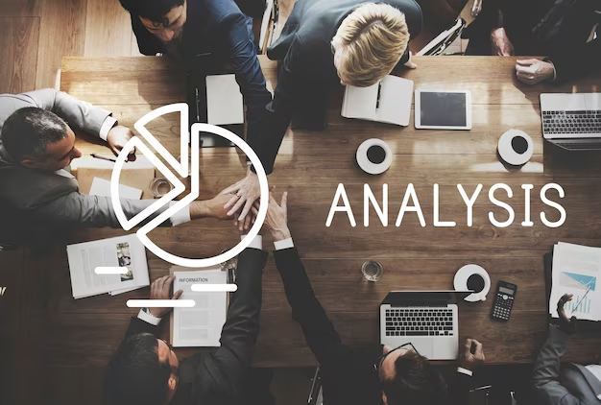
Analysis
data, data, data, data, data, data, data, data, data, data.\data . Data, data, data, . Data. Data .
Methodology, statistical techniques

Slide 15
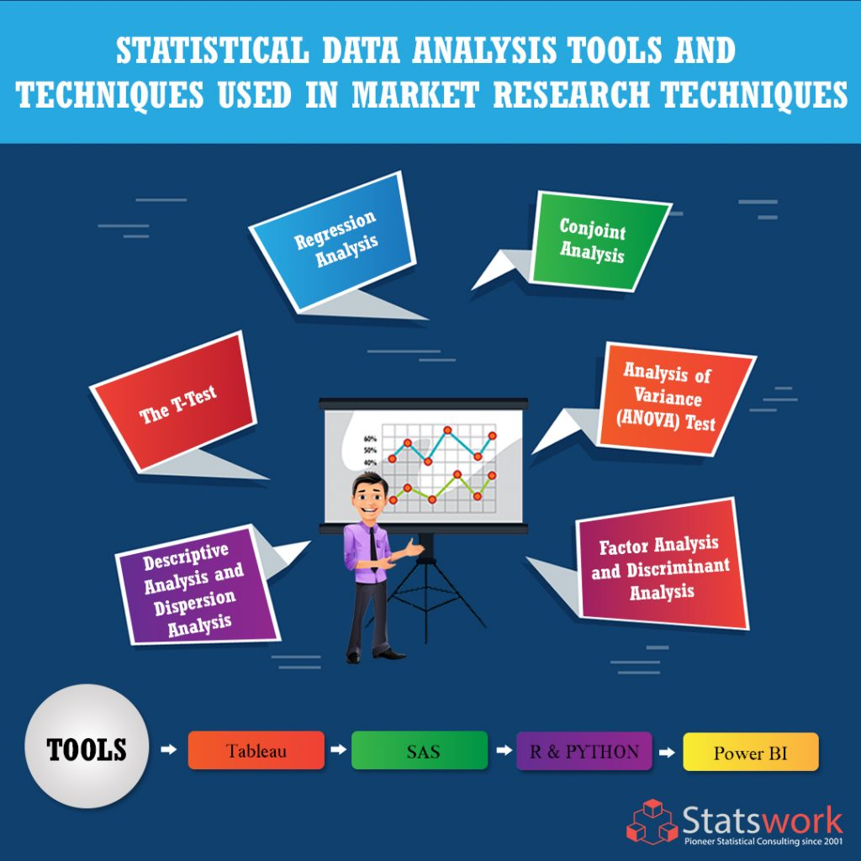
Methodology and Statistical Techniques used
The secondary dataset was collected from Kaggle after confirming that the dataset was previously scrapped from the official site of NPCI (National Payments Corporation of India). The dataset was then cleaned in Excel and loaded into Power BI for data visualization by creating dashboards. In addition, the dataset was loaded into R Studio for further analysis so as to know more about the Indian market as in the year 2022 for the months of January to July. The statistical techniques of correlation, linear regression, multiple linear regression, selection of best fit model using forward regression approach was taken into consideration to know more about the variables in the dataset.

Slide 16
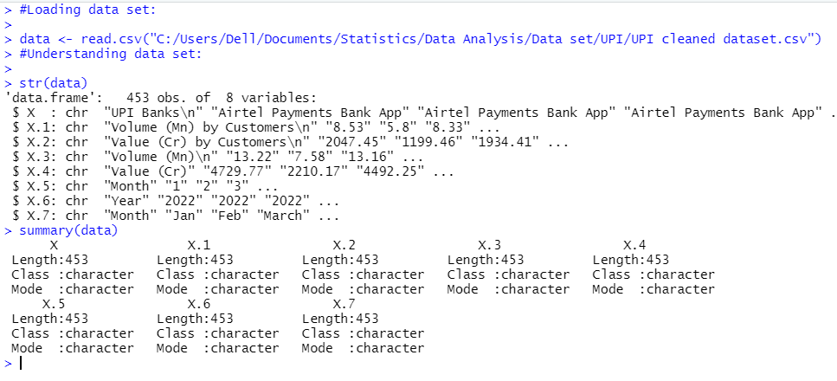
Analysis Using R Studio

Slide 17
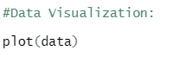
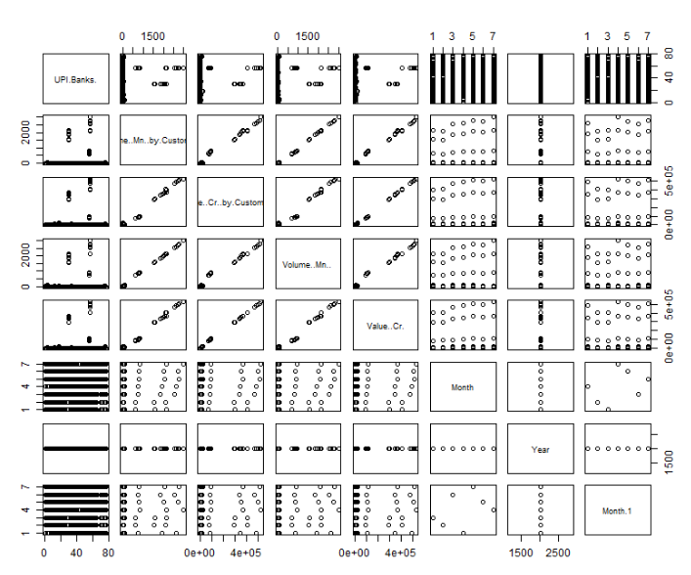

Slide 20
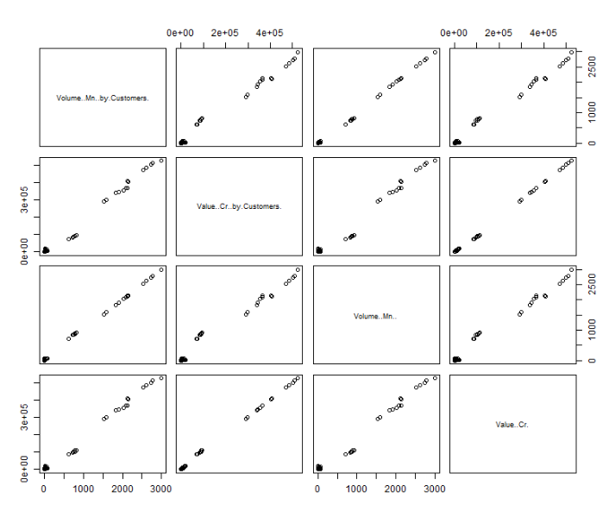

Slide 34
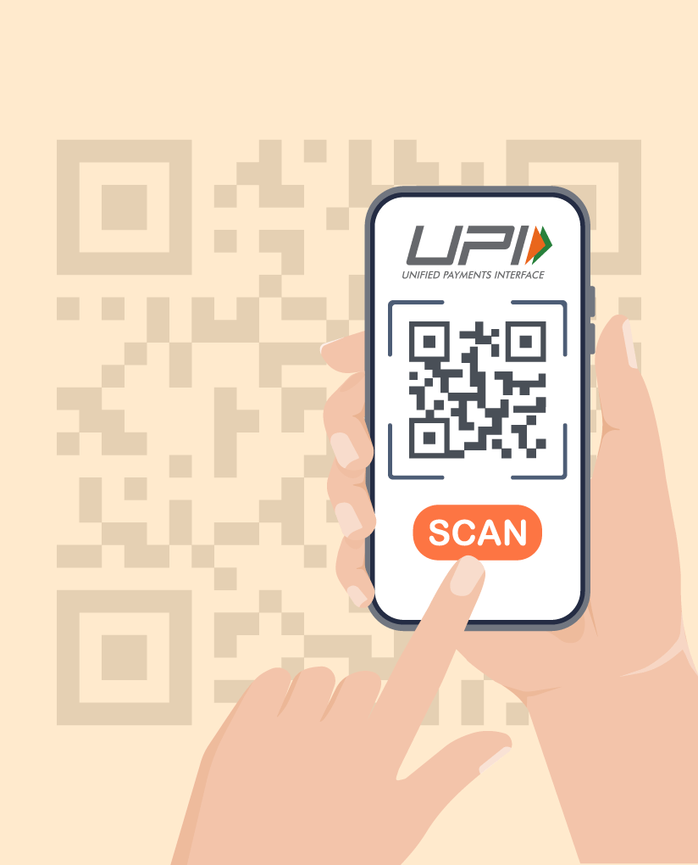
Summary
Group 2 group 2 group 2 group 2 group 2
From this Project we get to know that in the year 2022 for the months of Jan to July, PhonePe, Google pay, and Paytm are the top 3 UPI Apps being used in India both in terms of Value and Volume of transactions. We also see the growth in the use of UPI apps by every month. Then we see that there is high correlation between volume and value of transactions to which we were able to fit linear and multiple linear regression models which at the end gave us the best fit model having 99.97% of Adjusted R square.
With this we can say that India is growing rapidly and we as Indian can proudly say India is a country having highest digital transactions.

Slide 35
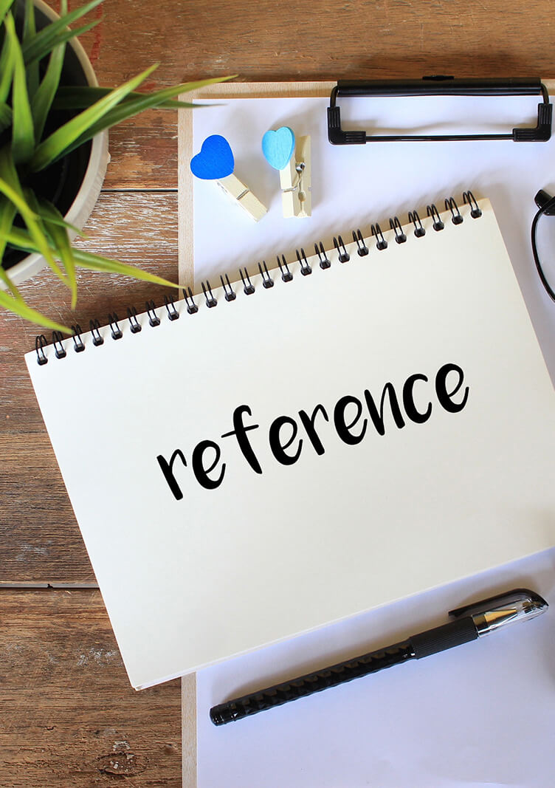
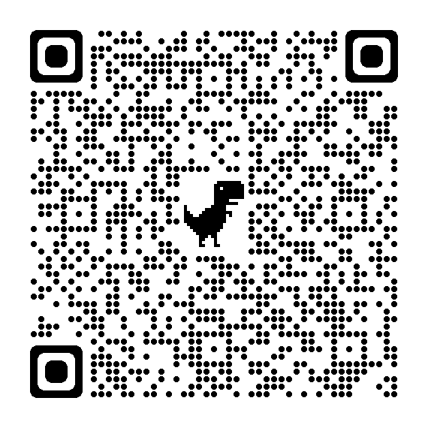
Sunny Gupta and Dinesh Chand (2021)
DATASET
https://drive.google.com/file/d/1Zhqbr9-Xs6Gl28MdN4e4t1vnOiTQau_s/view?usp=share_link
Arvind And Deepak Chaudhari (2019)
https://acsbodwadcollege.org/wp-content/uploads/2020/01/207-A_Arvind-Dipak-2019.pdf
PornaPushpak C and Pappsewari (2021)
QR to Kaggle showing the dataset
Link to the NPCI site:
https://www.npci.org.in/what-we-do/upi/upi-ecosystem-statistics#innerTabTwoDec23
https://www.annalsofrscb.ro/index.php/journal/article/download/7898/5834/14071

Slide 36

Thank you
Chavi
M.Sc Statistics (2nd year)
MENTOR:
Swapna Mam

